Slide 1
Cinnamon Babka for the Beginning Baker
Presented by Marc Zimmerman,
A software engineer who bakes

Slide 2
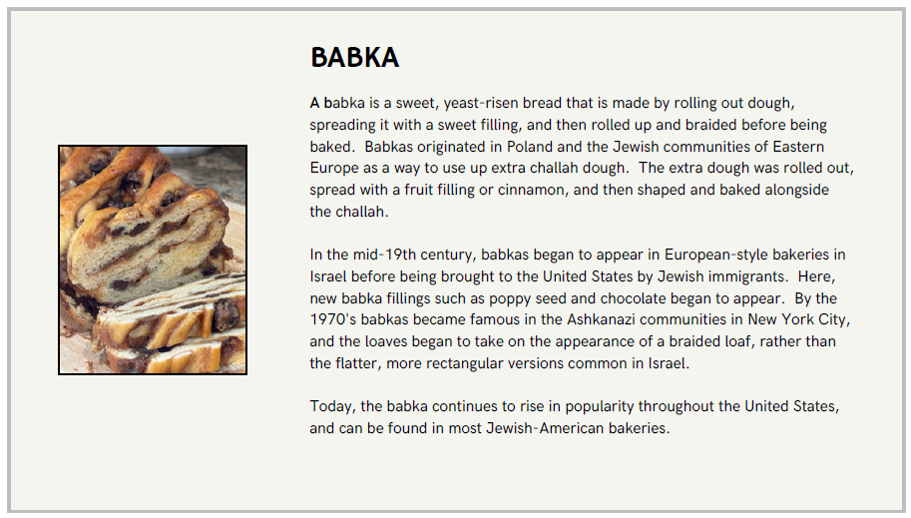
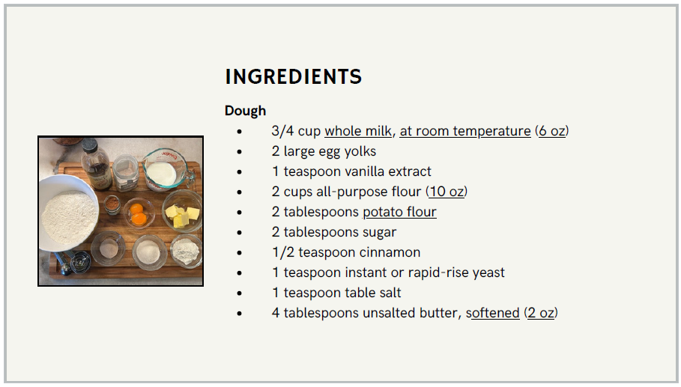
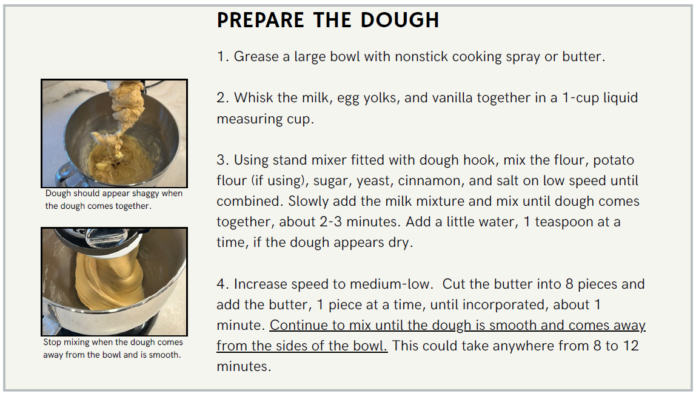
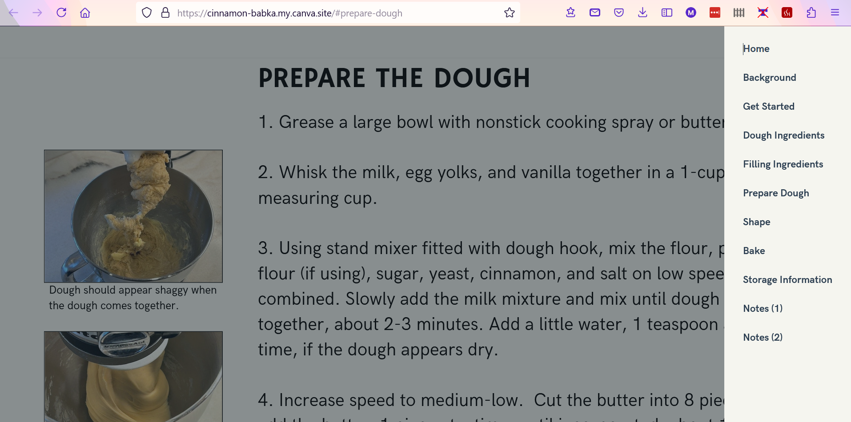
An Online Babka Recipe for the Beginning Baker
Website
Navigation Bar
Underline links to Notes section
Notes:
A babka can be complicated to prepare.
However, my instruction problem was to develop a recipe for a babka that can be successfully executed by the novice baker.
I developed the recipe for a website, rather than a printed recipe, because
1) I wanted to gain experience with Canva, and
2) Most users are comfortable accessing recipes online
It follows a standard online recipe format with traditional information chunking….intro, ingredients, procedure, etc.
There is also a Notes section with supplemental information
To move around,
It contains a navigation bar
ALSO HAS HYPERLINKS that take the user to the Notes section if additional information is desired.
(Graphics help illustrate procedure. Graphics are static. Feedback was for videos)

Slide 3
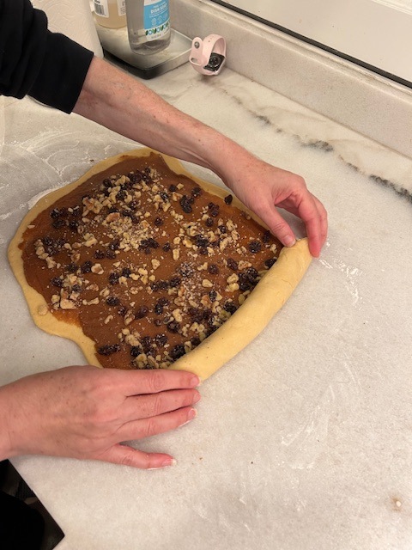
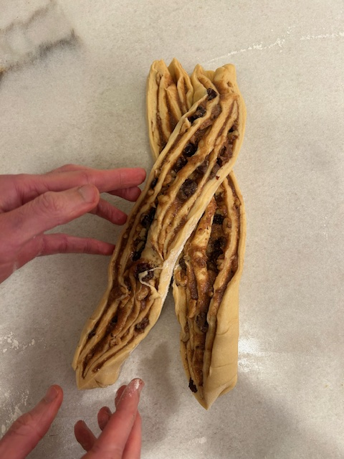
Value to Target Audience
Provides an easily understood recipe
Supplemental instruction and graphics
Provides encouragement and motivation
Provides easy access in both desktop and mobile environments
Usable by experienced bakers as well
Offers continuing support - TBD
Notes:
At a high level, I provide an easily understood recipe, which resulted from feedback from the test audience.
Static graphics help with that! (although feedback mentioned video)
Encouragement in the form of an introduction. I find it distracting, but target audience appreciated it.
Encouragement also in the form of friendly tone.
Used in both desktop and mobile environments to increase its accessibility
Can also be used by EXPERIENCED bakers. Tried to provide a concise recipe, with additional explanations provided separately.

Slide 4
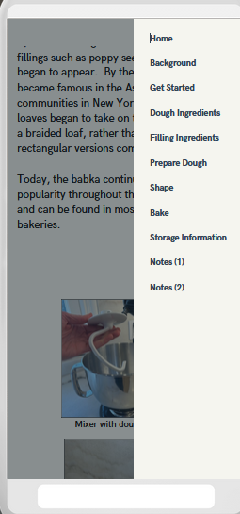

Project highlights
Utility of test audience
In-person vs Remote
Unable to see recipe executed
Experience with Canva
Pros
Ease of use
Variety of templates
Help
Desktop vs Mobile
Cons
Pop-ups
Single web page
Notes:
My biggest takeaway was the utility of a test audience.
Helped with layout and wording.
Unfortunately, all of my test audience was remote. Seeing testers in person would have allowed me to better pinpoint areas of confusion.
I also developed a lot of experience with Canva.
The biggest problem I had with Canva is that it doesn’t support a lot of functions like pop-ups. So, users have to implement somewhat clunky workarounds to implement them.

Slide 5
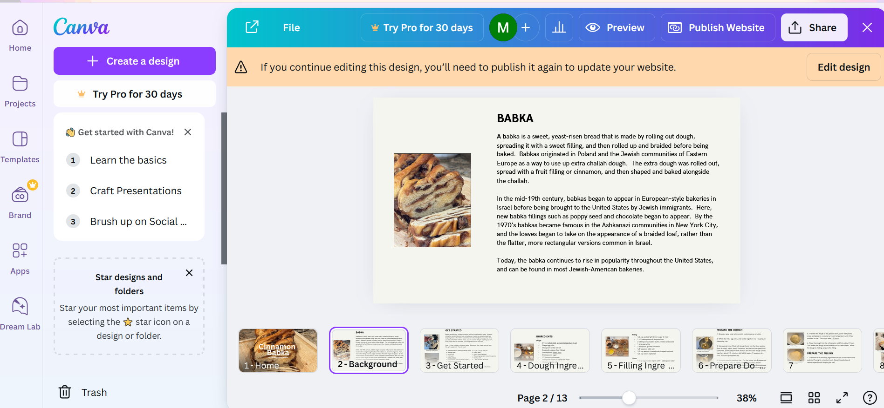
Closing
Canva
Practical tool for creating websites quickly
Speed and ease comes to the detriment of flexibility
Use of test audience is important
Wide range of culinary knowledge
Notes:
Canva was a practical tool for creating websites quickly.
Speed and ease comes to the detriment of flexibility.
I also found that using a test audience is critical. I found that the amount of knowledge a self-described “beginning baker” has can vary widely, so I definitely would have appreciated a larger test audience in order to figure out what base level of knowledge I could assume.

